Slide 1
Trees & application of trees
Coral S. Schmidt Montilla

Slide 2
INTRODUCTION
Discrete mathematics is a branch of mathematics that deals with discrete objects, such as integers and graphs. One important concept in discrete mathematics is that of a tree graph. Tree graphs are a special type of graph in which there are no cycles and it is connected, meaning that there is a unique path between any two nodes in the graph. There are several types of tree graphs, each with their own unique properties and applications in real-life.

Slide 3
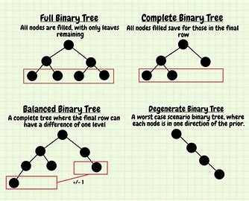
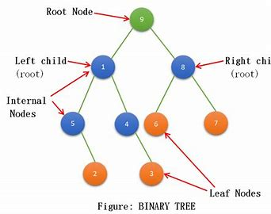
Binary Tree
A binary tree is a tree graph in which each node can have at most two child nodes.
This type of tree is commonly used in computer science to represent hierarchical data structures, such as file systems and decision trees. In a file system, the root node represents the top-level directory, and the child nodes represent subdirectories and files.
Similarly, a decision tree can be used to represent a set of rules for making decisions, with the root node representing the initial decision, and the child nodes representing possible outcomes.
Binary trees are also used in algorithms, such as search and sorting algorithms, as well as in data compression and encryption.

Slide 4
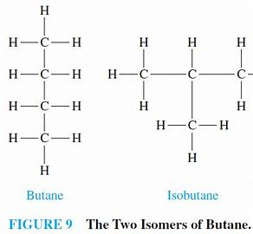
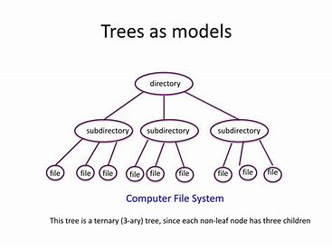
Trees as modles

Slide 5
Properties of trees
In discrete structures, trees are hierarchical data structures that are used to represent a collection of elements with a parent-child relationship.
Trees have several properties, such as being acyclic, connected, and having a unique root node.
Each node in the tree can have one or more children, but only one parent, which forms the basis for the parent-child relationship.
Additionally, the height of a tree is defined as the number of edges from the root to the deepest leaf node.
These properties of trees make them useful in many applications, such as file systems, decision trees, and graph theory.

Slide 6
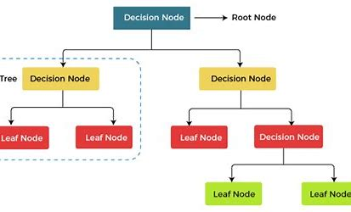
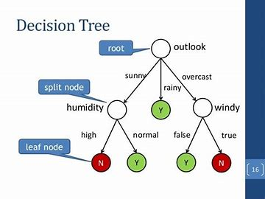
Decision Trees
Decision trees in discrete structures are a type of machine learning algorithm used for classification and prediction problems.
They work by recursively partitioning the data into smaller subsets based on the values of the features, and making predictions at each node based on the most prevalent class in the current subset.
Decision trees are easy to interpret, understand and visualize, making them a popular choice for discrete data sets where the relationship between features and the target variable is not linear.
However, they can be prone to overfitting and can benefit from pruning techniques to improve their generalization performance.

Slide 7
Prefix Codes
Prefix codes in discrete structures are codes that have the property that no code word is a prefix of another code word.
This means that a code word can be unambiguously reconstructed from the prefix, without having to wait for more information to arrive.
This is particularly important in computer communication, where data is transmitted in a serial fashion and having prefix codes ensures that there is no ambiguity in decoding the information.
The most commonly used prefix codes are the Huffman codes, which are used in image and video compression, and the arithmetic coding, which is used in text compression.
These codes have the advantage of being efficient, easy to implement, and easy to decode, making them a popular choice in many applications.

Slide 8
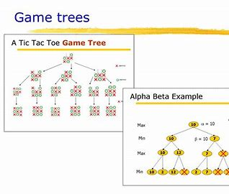
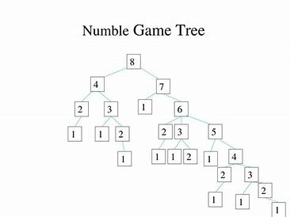
Game trees
Game trees are a fundamental concept in discrete structures, used to model decision-making scenarios in various applications such as computer games, economics, and artificial intelligence.
A game tree is a directed graph where nodes represent game positions and edges represent possible moves.
The branches of the tree represent different sequences of moves, and the leaves of the tree are the final positions of the game.
The concept of game trees allows us to analyze different scenarios and find the optimal move for a player.
In computer games, the game tree can be used to predict the best move for a computer player, while in economics it can be used to determine the most profitable decision in a bargaining scenario.
The study of game trees is an important aspect of discrete mathematics and provides a solid foundation for further exploration into algorithms and decision-making.

Slide 9
THANK YOU
In conclusion, tree graphs are an important concept in discrete mathematics and have many real-life applications. Different types of tree graphs are used for different purposes, such as representing hierarchical data structures, sorting and searching algorithms, and efficient storage and retrieval of data. Understanding the properties and applications of different types of tree graphs is crucial for the understanding of many important problems and phenomena in computer science and engineering.

